Slide 1

MEDIA & THE PUBLIC
Week 7 Fact-checking & Third person effect
Ryan Wang
ryanyang@psu.edu

Slide 2
What &Why: experiment design (randomized controlled trials)

Slide 3
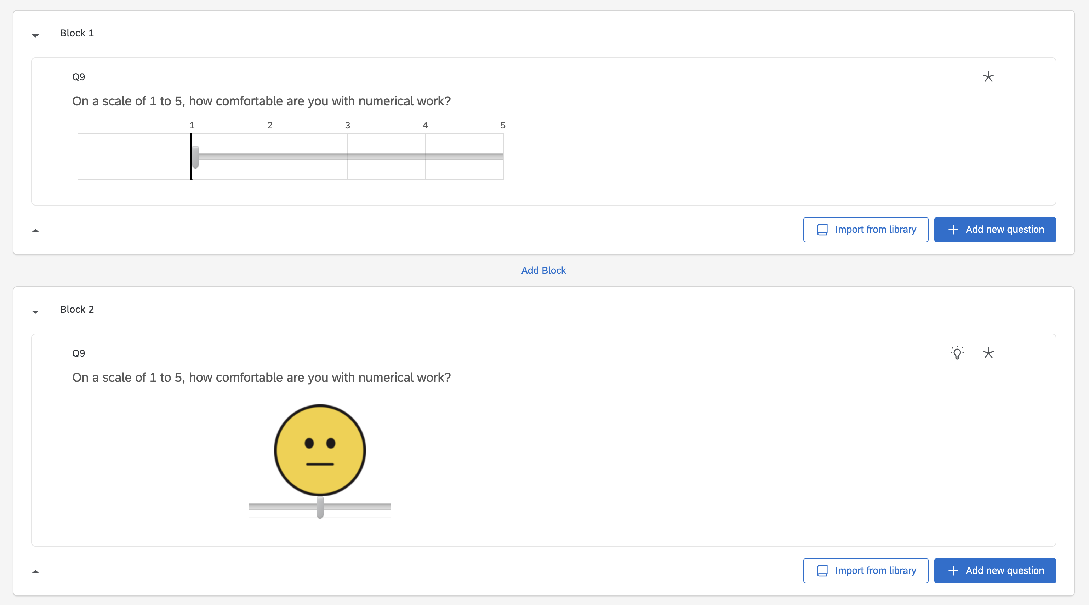
Remember our pre-course survey? It is an experimental design!

Slide 4
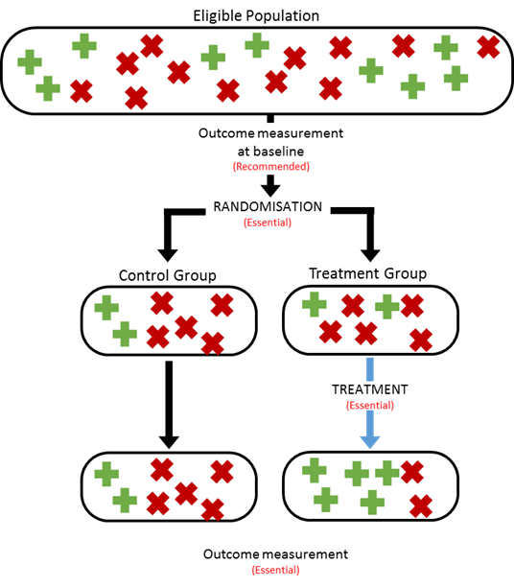

Slide 5
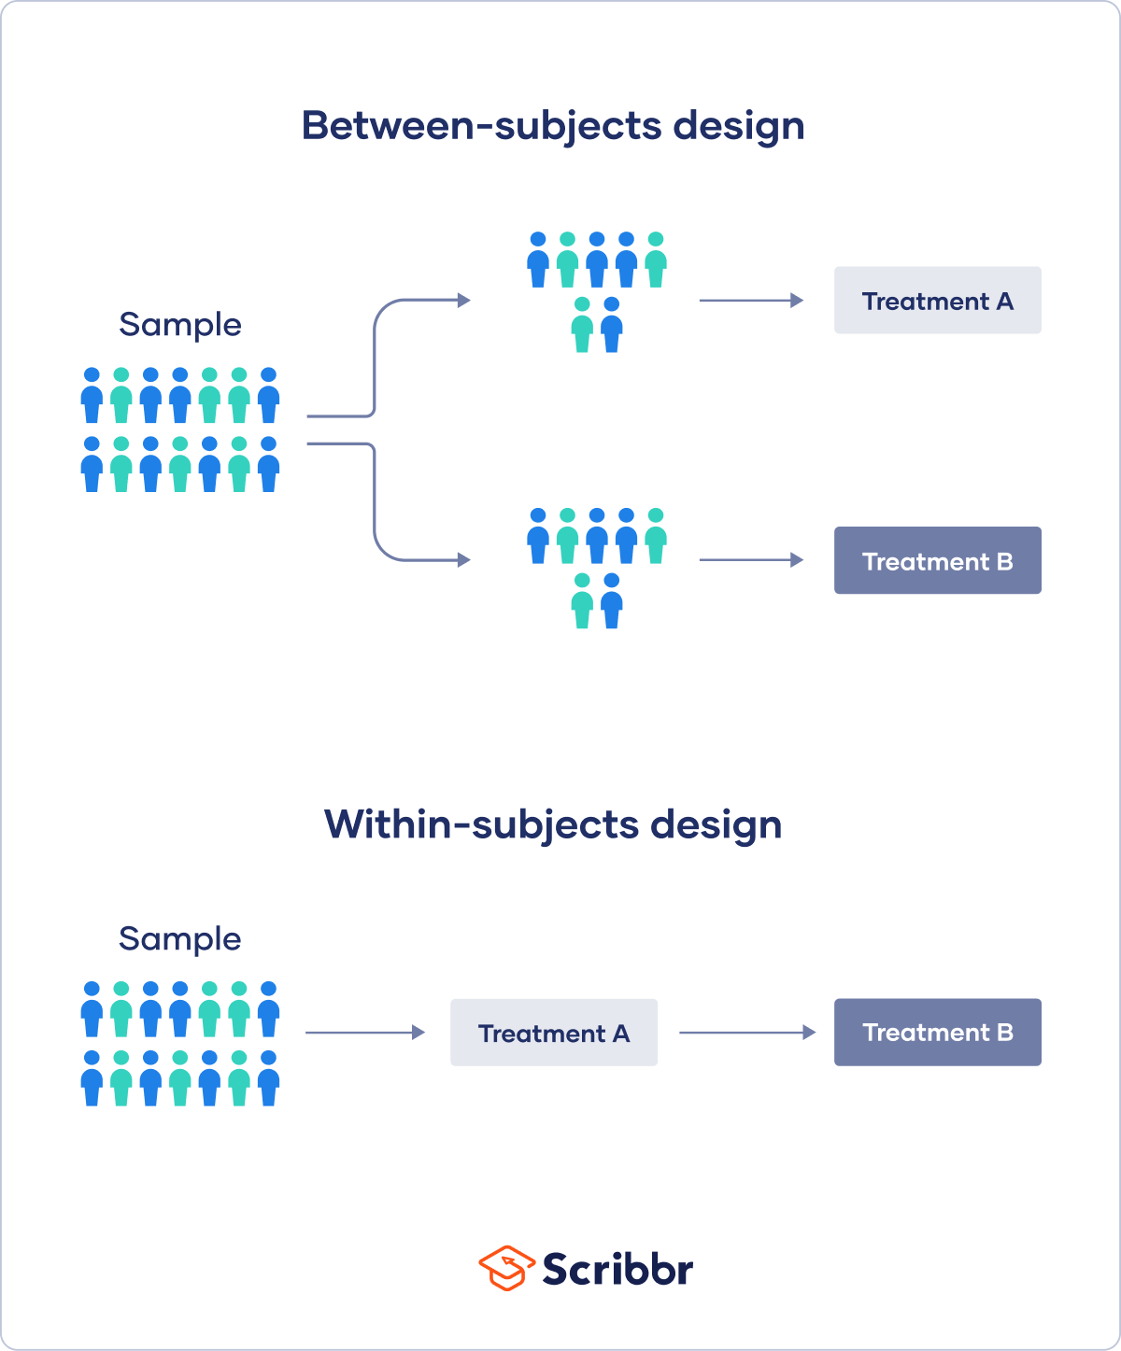

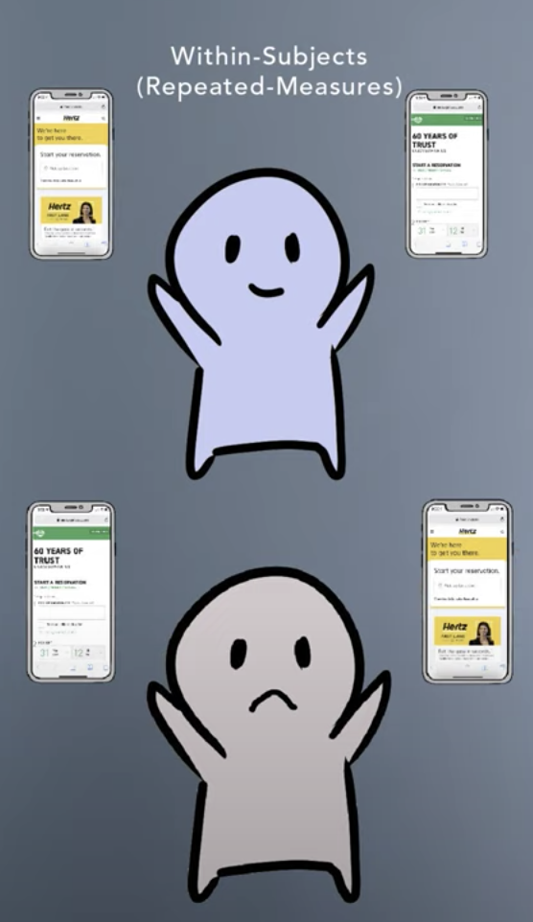

Slide 6
Types of experimental design
Randomization is essential for both types of experimental designs!
Between-subject design:
Each participant receives only one of the possible treatment and their responses to the treatment are measured afterward
Minimize the learning and transfer effect across conditions
Time-saving (shorter sessions)
Easier to set-up (especially for multiple IVs – factorial design)
With-in design (repeated measure design):
Each participant receives each of the treatment consecutively and their responses to each treatment are measured.
Able to measure effects emerges over time
Lower cost and require fewer participants
Minimize the random noise

Slide 7
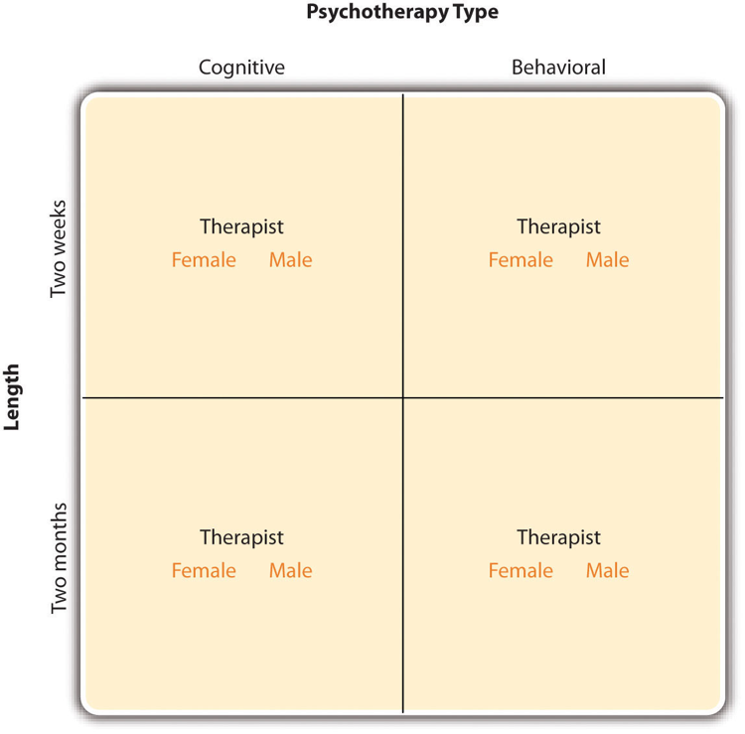
Types of experimental design
Factorial design (multiple IVs)
2 (Psychotherapy type: cognitive & behavioral) x 2 (Length: Two weeks & Two months)
2 (Psychotherapy type: cognitive & behavioral) x 2 (Length: Two weeks & Two months) x 2 (Gender: Female & Male)

Slide 8
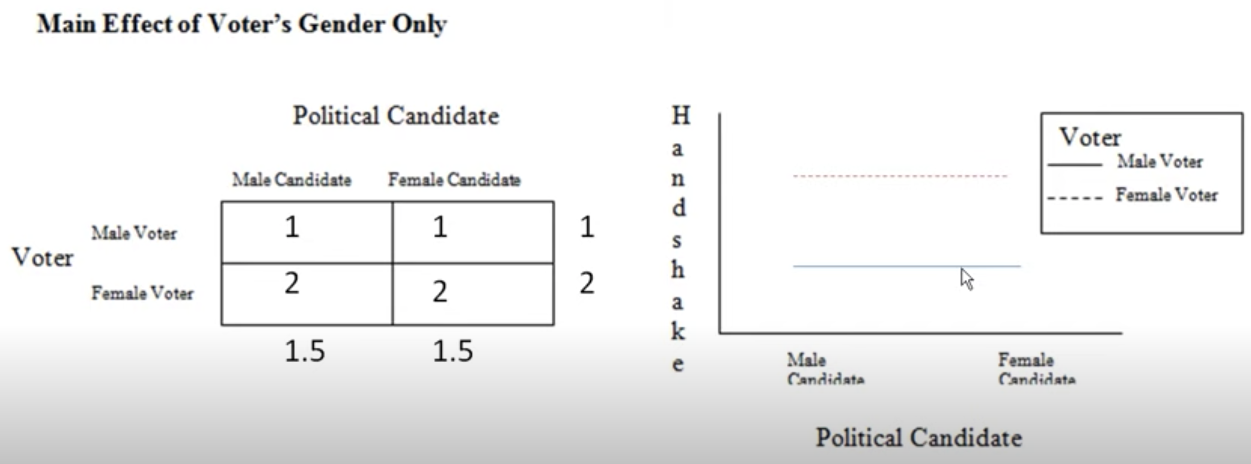
Main effects and interaction

Slide 9
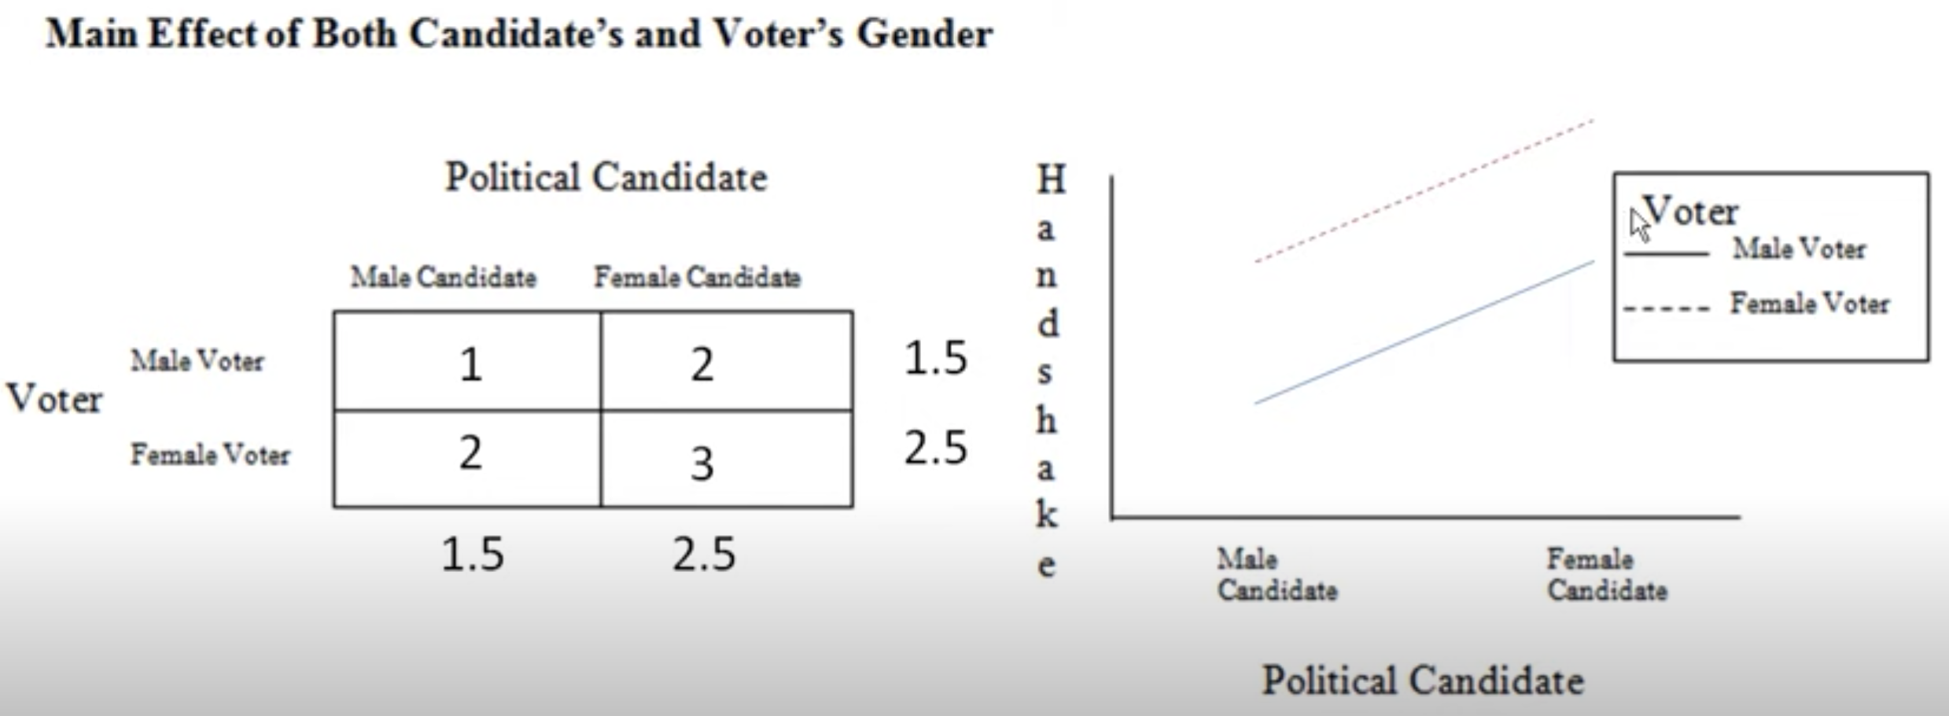
Main effects and interaction

Slide 10
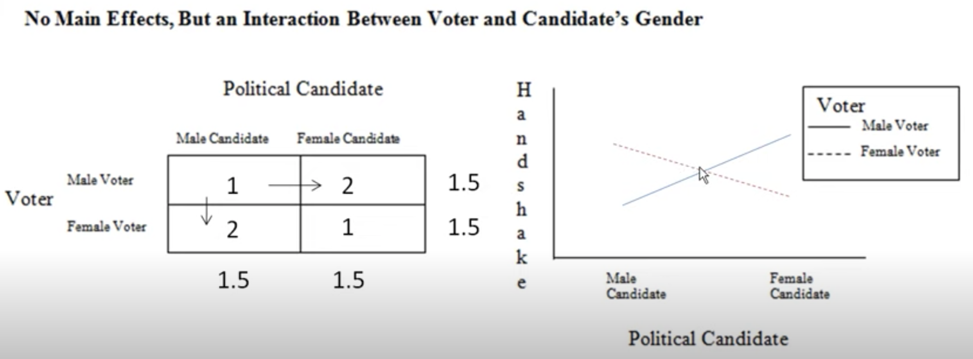
Main effects and interaction

Slide 11
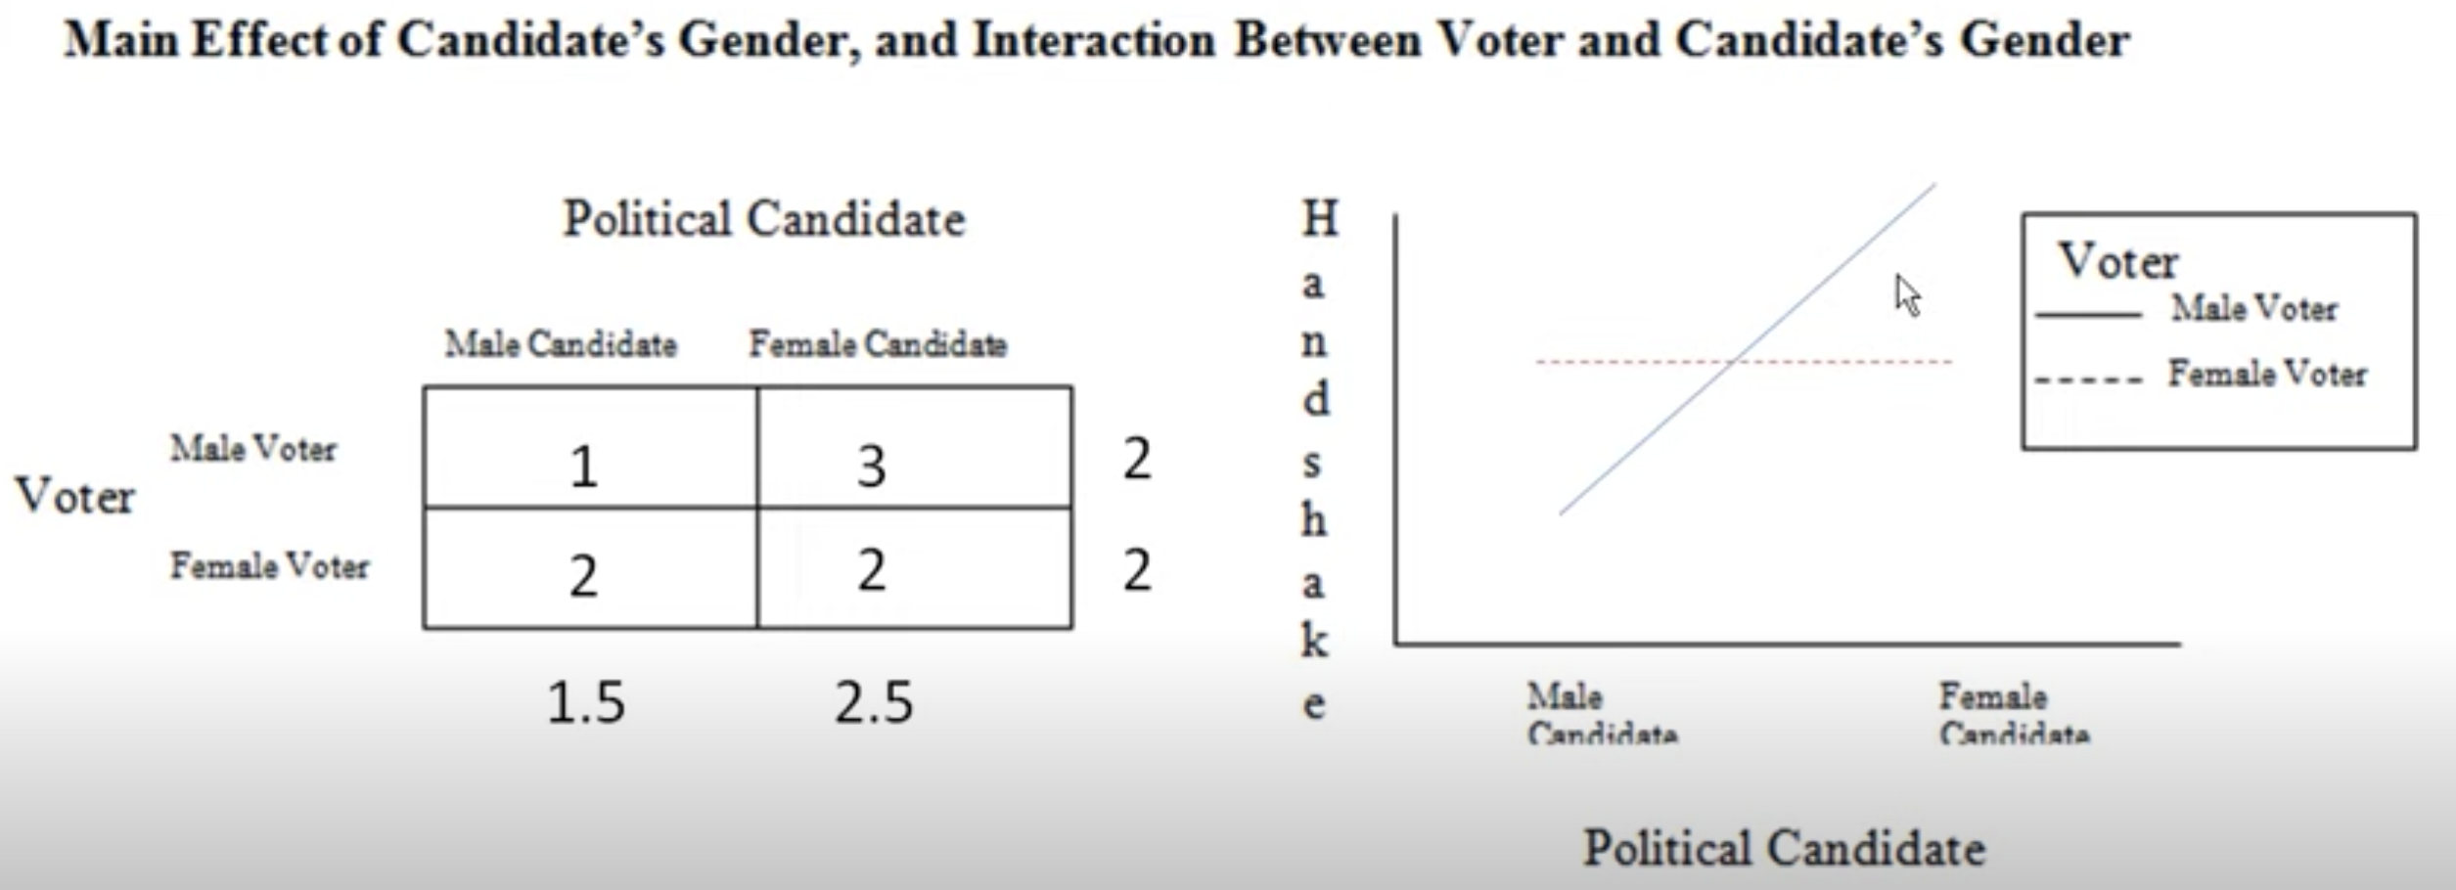
Main effects and interaction

Slide 12
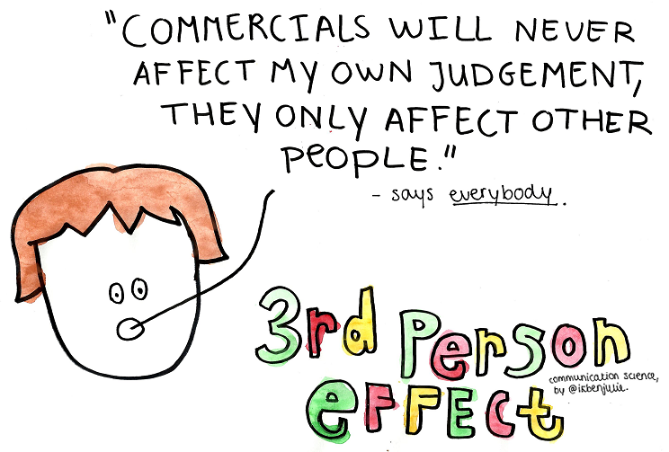
The third-person effect

Slide 13
The third-person effect (Davidson, 1983)
Theoretical foundations
Attribution theory: the tendency to underestimate the impact of situational factors and overestimate the role of dispositional factors (Heider, 1958).
Standley(1994): effects of TV on audience (dispositional factors) vs. on themselves (situational factors)
Biased Optimism: self-serving bias, people evaluate themselves more favorably than they evaluate others (Weinstein & Klein, 1996).
Hypothesis A: negative events less likely to happen to them than to others (third person effect!)
Hypothesis B: positive events more likely to happen to them than to others (first person effect).
Components:
Perceptual: People tend to overestimate the influence that mass communications have on the attitudes and behavior of others.
Behavioral: Whether or not these people are among the ostensible audience for the message, the impact they expect this communication to have on others may lead them to take some action.

Slide 14
The third-person effect (Davidson, 1983)
Other applications
Political behavior (Hollander, 1979)
1978 Maryland gubernatorial primary election (Harry Hughes)
Newspaper endorsement of the candidate changed the expectations about the support he would receive, but not the attitudes towards the candidate.
People voted for him.
Fluctuations in stock market, consumer goods supplies, body image & anxiety..
Connection with other phenomena
Media bias: People on both sides of an issue see the media as biased against their own point of view
Why? The third persons will be affected by the arguments supporting the “wrong” side of the issue.
How? Balanced media representation requires a sharp tilt towards the ”correct” side, compensating for the intellectual frailty of third persons.
Spiral of Silence: Those on one side of issue express their opinions with more confidence, while the other side remain silent (Noelle-Neumann, 1980).
Exaggerated perceptions of mass media effects on others undecided voters opted for the party which ”seems to be attracting greater number of supporters”.

Slide 15
Chung & Kim (2020): When I Learn the News is False: How Fact-Checking Information Stems the Spread of Fake News Via Third-Person Perception

Slide 16
Research questions & Hypotheses
Study 1
H1: Those who viewed a news story with debunking fact-checking information will report lower perceived quality of the news than those who viewed the news story without fact-checking information.
H2: Those who viewed a news story with debunking fact-checking information will report greater TPP than those who viewed the news story without fact-checking information (a hidden RQ: does the perceived influence of fake news on the self or others play a more important role here?)
H3: Increased TPP as a function of fact-checking (H2) will mediate the influence of fact-checking on social sharing intentions (such that those who viewed a news story with debunking fact-checking information will report weaker intentions to share the news on social media than those who viewed the news story without fact-checking information)
Study 2
H1, H2, H3
H4: The effect of social media metrics on TPP and social sharing intentions will be moderated by fact-checking information, such that the effect will be attenuated when the news is debunked by fact-checking information.

Slide 17
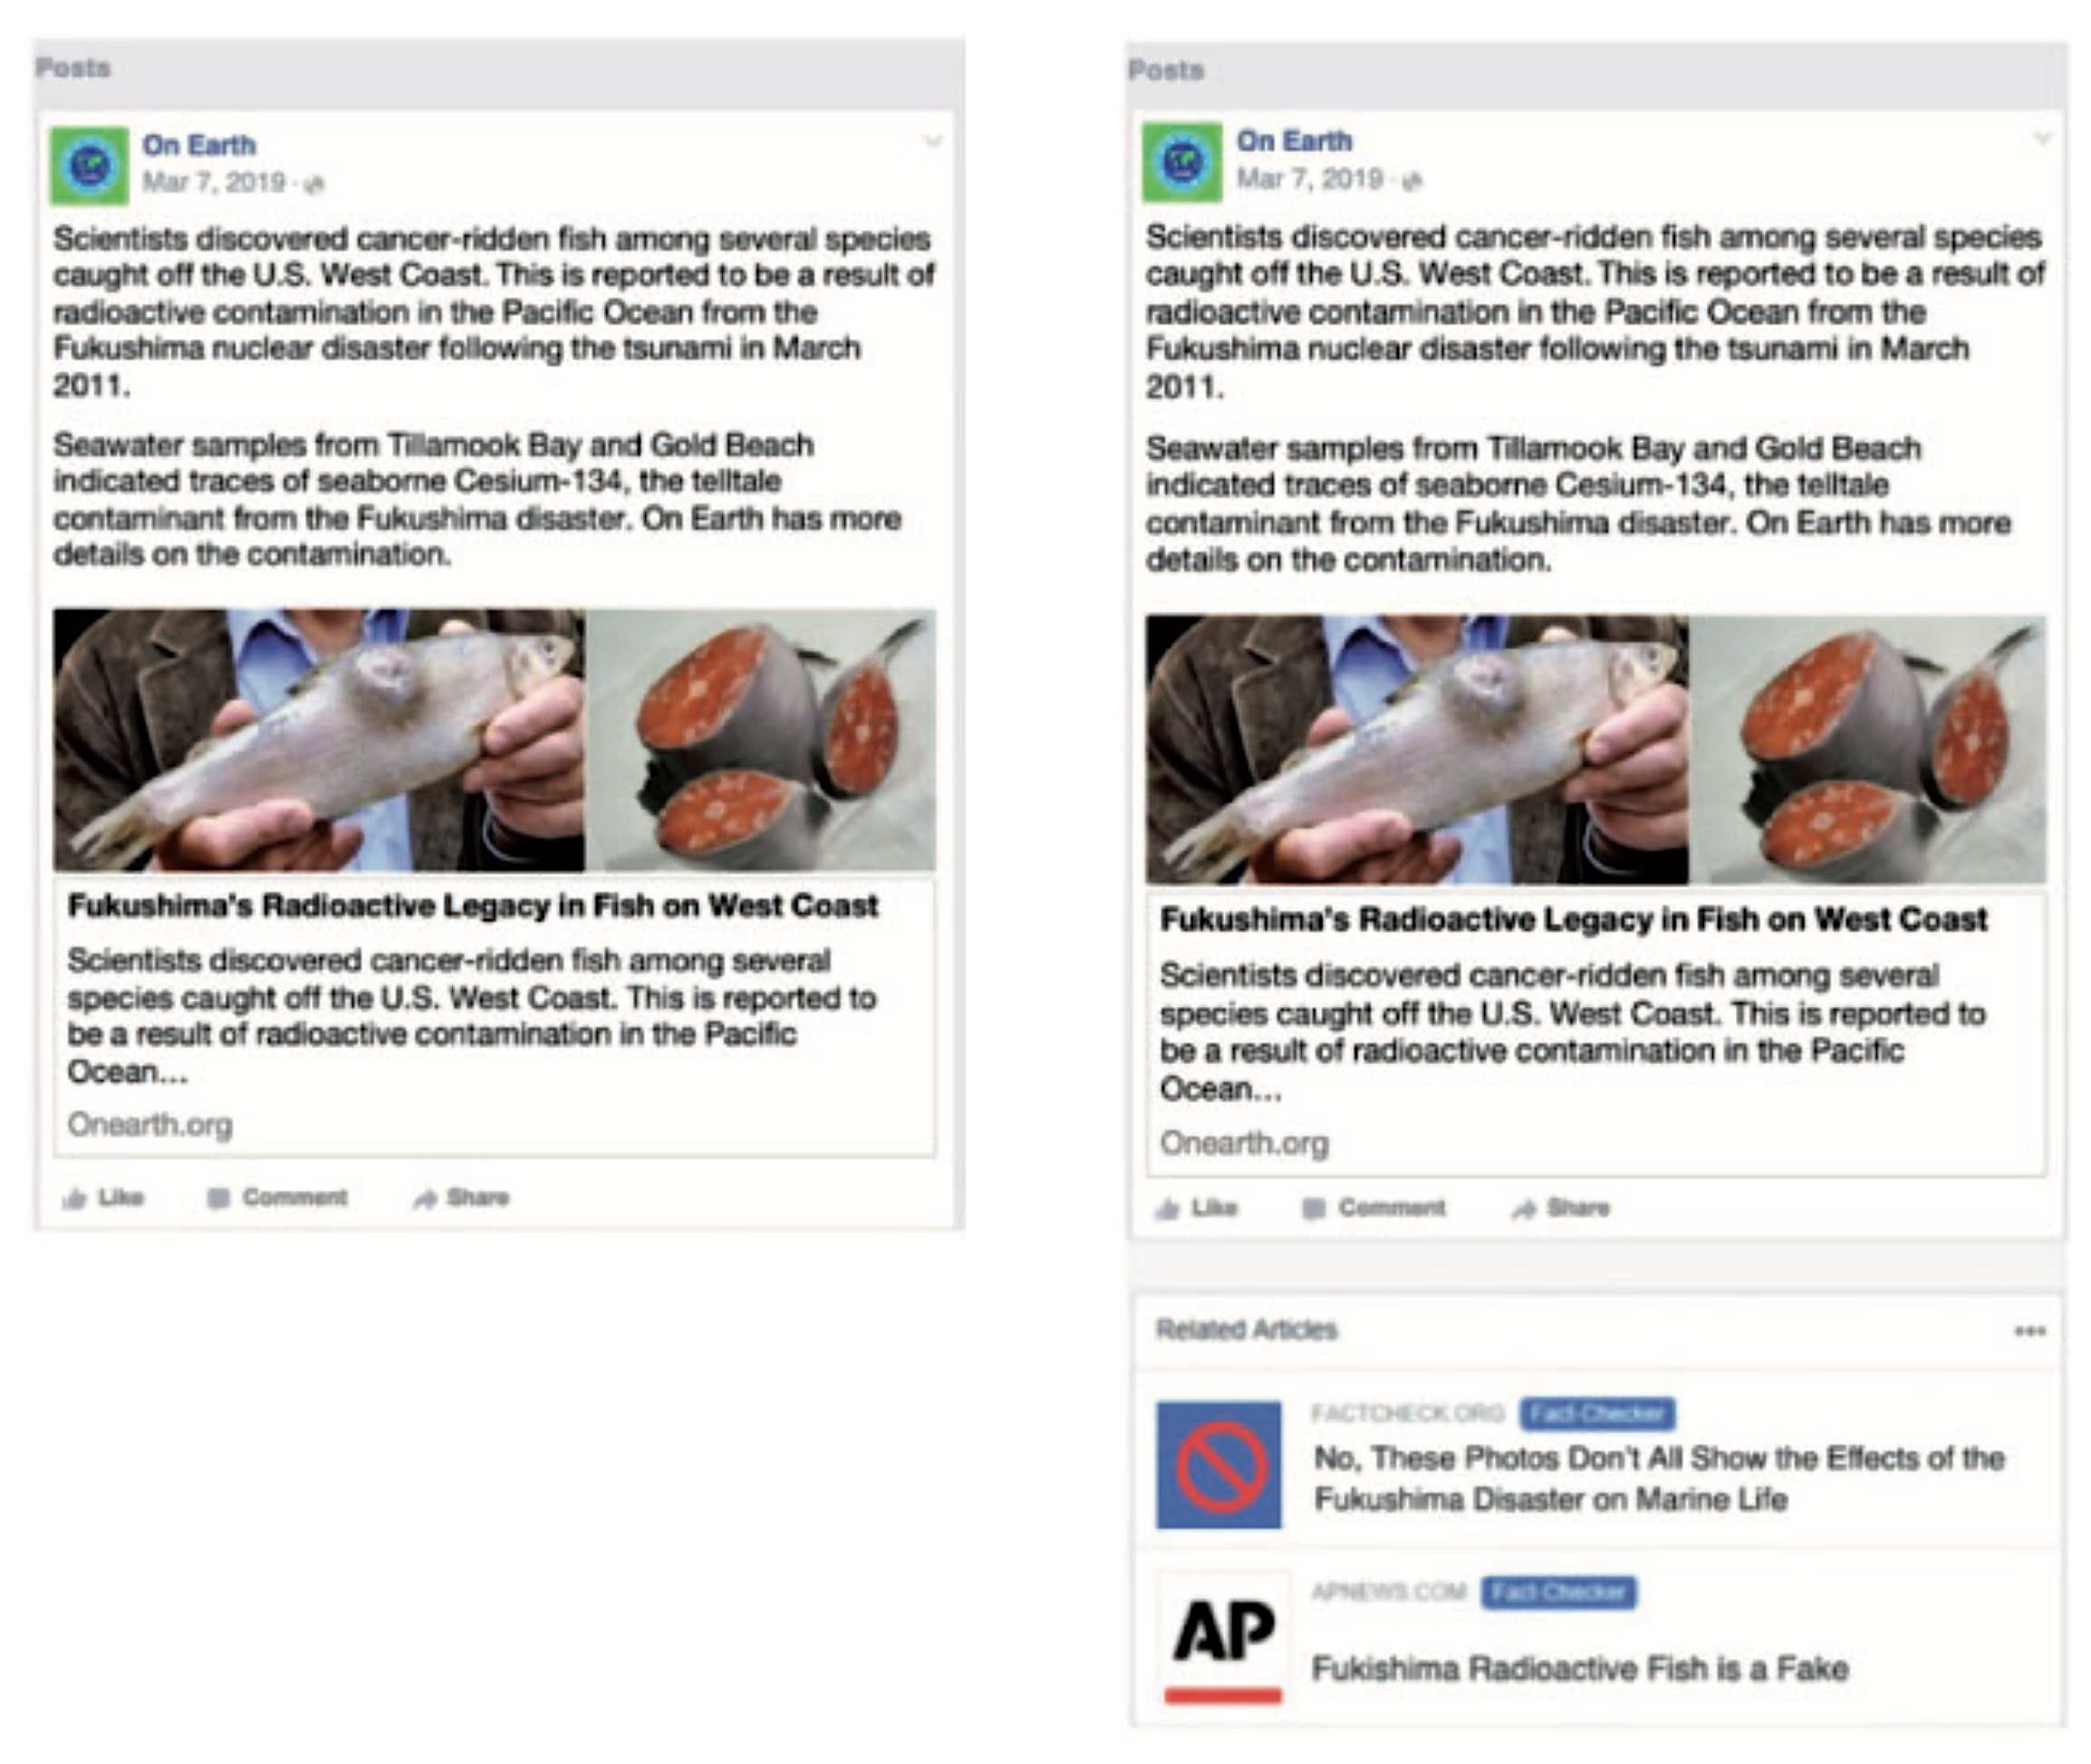
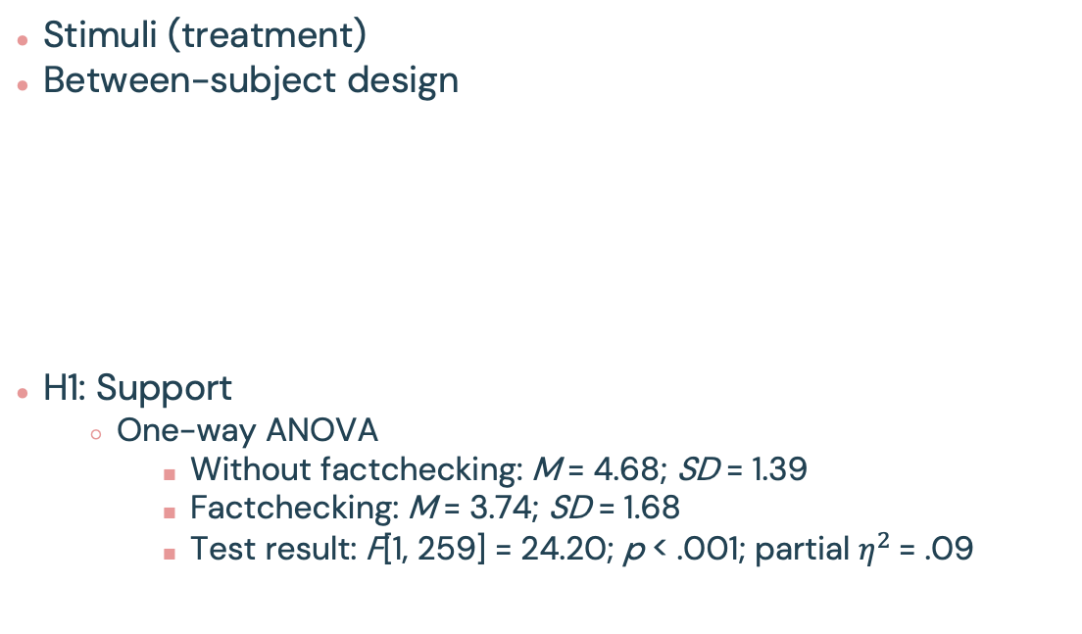
Study 1
Stimuli (treatment)
Between-subject design
H1: Support
One-way ANOVA
Without factchecking: M = 4.68; SD = 1.39
Factchecking: M = 3.74; SD = 1.68
Test result: F[1, 259] = 24.20; p < .001; partial $η^{2}$= .09
Notes:
Partial eta squared is a way to measure the effect size of different variables in ANOVA models.
It measures the proportion of variance explained by a given variable of the total variance remaining after accounting for variance explained by other variables in the model.

Slide 18
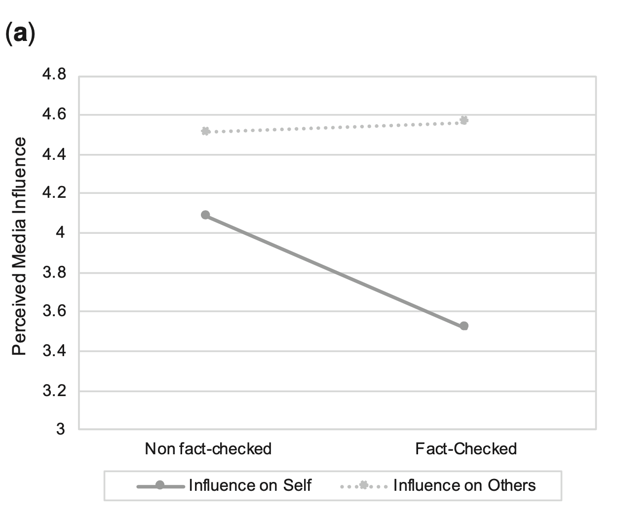
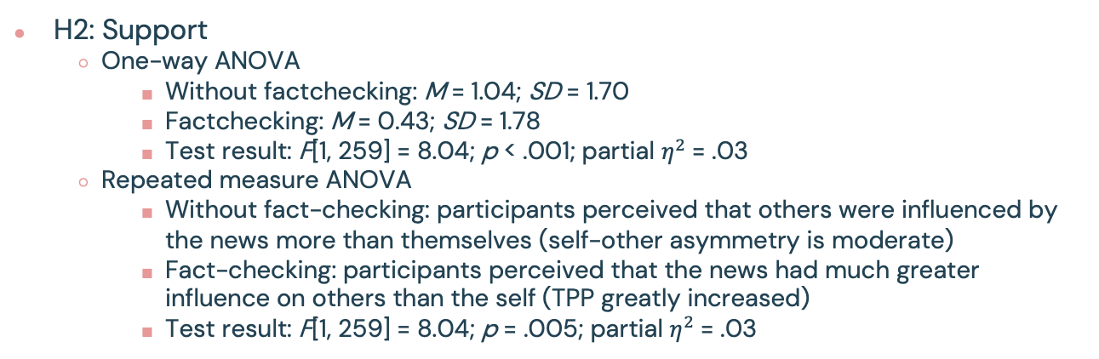
Study 1
H2: 2 (fact-checking status: news without fact-checking information vs. news with debunking fact-checking information) x 2 (perceived influence: self vs. others)
H2: Support
One-way ANOVA
Without factchecking: M = 1.04; SD = 1.70
Factchecking: M = 0.43; SD = 1.78
Test result: F[1, 259] = 8.04; p < .001; partial $η^{2}$= .03
Repeated measure ANOVA
Without fact-checking: participants perceived that others were influenced by the news more than themselves (self-other asymmetry is moderate)
Fact-checking: participants perceived that the news had much greater influence on others than the self (TPP greatly increased)
Test result: F[1, 259] = 8.04; p = .005; partial $η^{2}$= .03
Notes:
Data suggest that the increased TPP is largely due to reduced media influence on the self, rather than increased media influence on others.

Slide 19
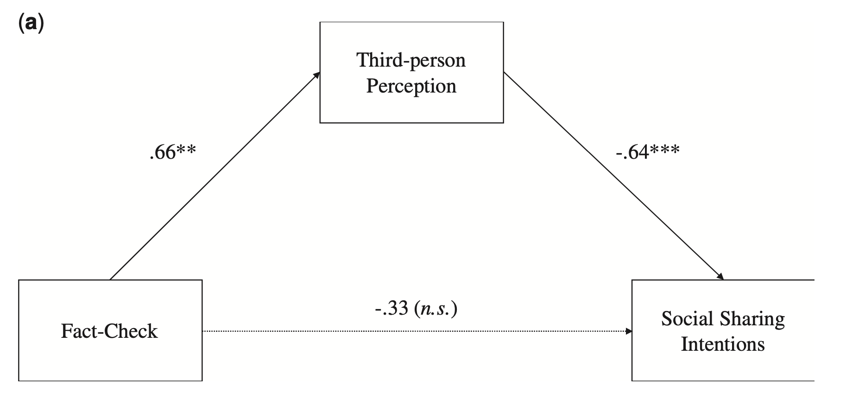
Study 1
H3: Support
Notes:
The analysis revealed that fact-checking information decreased social sharing intentions via TPP

Slide 20
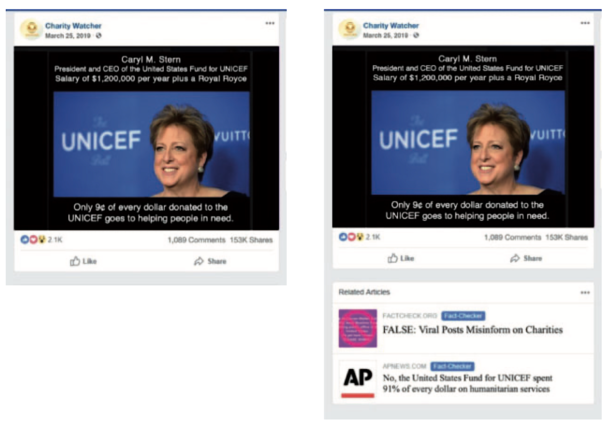
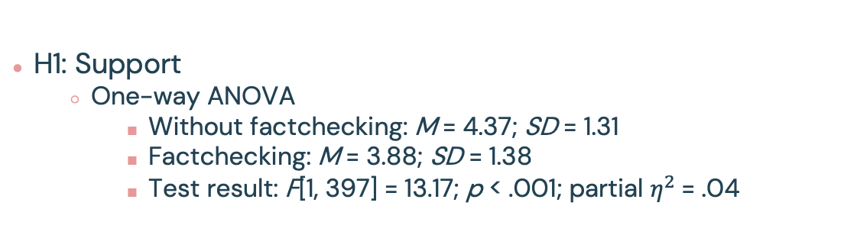
Study 2
Stimuli (treatment)
Factorial design
2 (fact-checking status: news without fact-checking information vs. news with debunking fact-checking information) x 2 (social media metrics: high vs. low)
H1: Support
One-way ANOVA
Without factchecking: M = 4.37; SD = 1.31
Factchecking: M = 3.88; SD = 1.38
Test result: F[1, 397] = 13.17; p < .001; partial $η^{2}$= .04

Slide 21
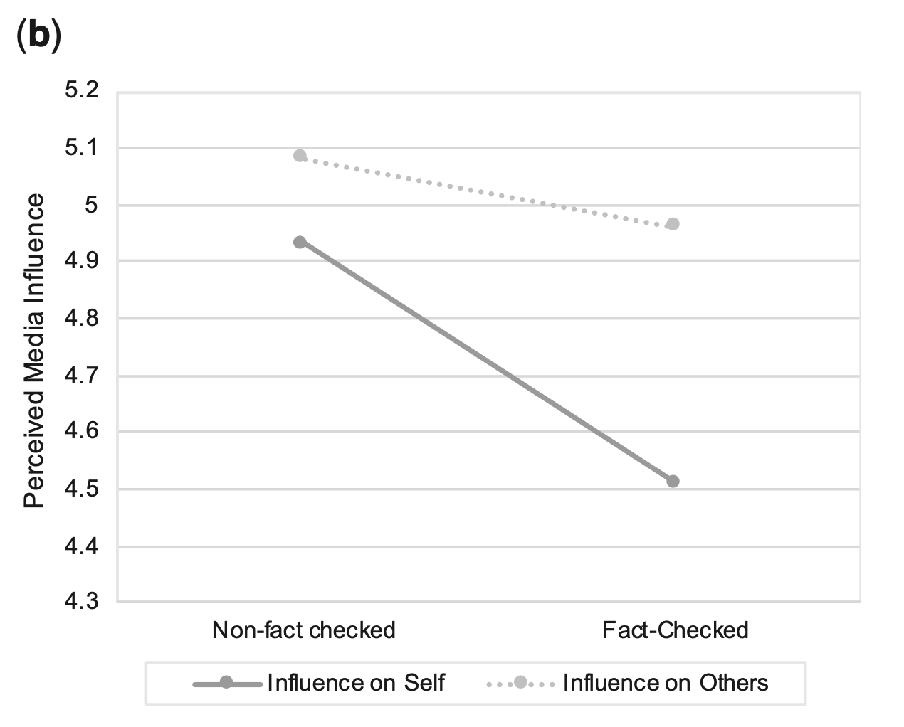
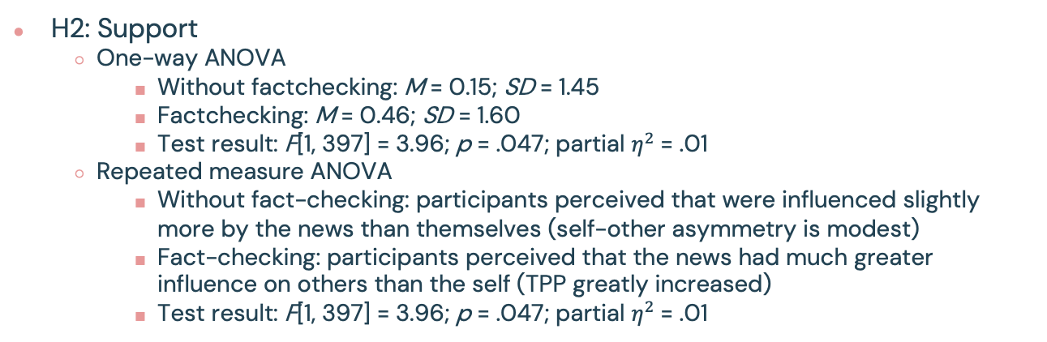
Study 2
H2: 2 (fact-checking status: news without fact-checking information vs. news with debunking fact-checking information) x 2 (social media metrics: high vs. low)
H2: Support
One-way ANOVA
Without factchecking: M = 0.15; SD = 1.45
Factchecking: M = 0.46; SD = 1.60
Test result: F[1, 397] = 3.96; p = .047; partial $η^{2}$= .01
Repeated measure ANOVA
Without fact-checking: participants perceived that were influenced slightly more by the news than themselves (self-other asymmetry is modest)
Fact-checking: participants perceived that the news had much greater influence on others than the self (TPP greatly increased)
Test result: F[1, 397] = 3.96; p = .047; partial $η^{2}$= .01

Slide 22
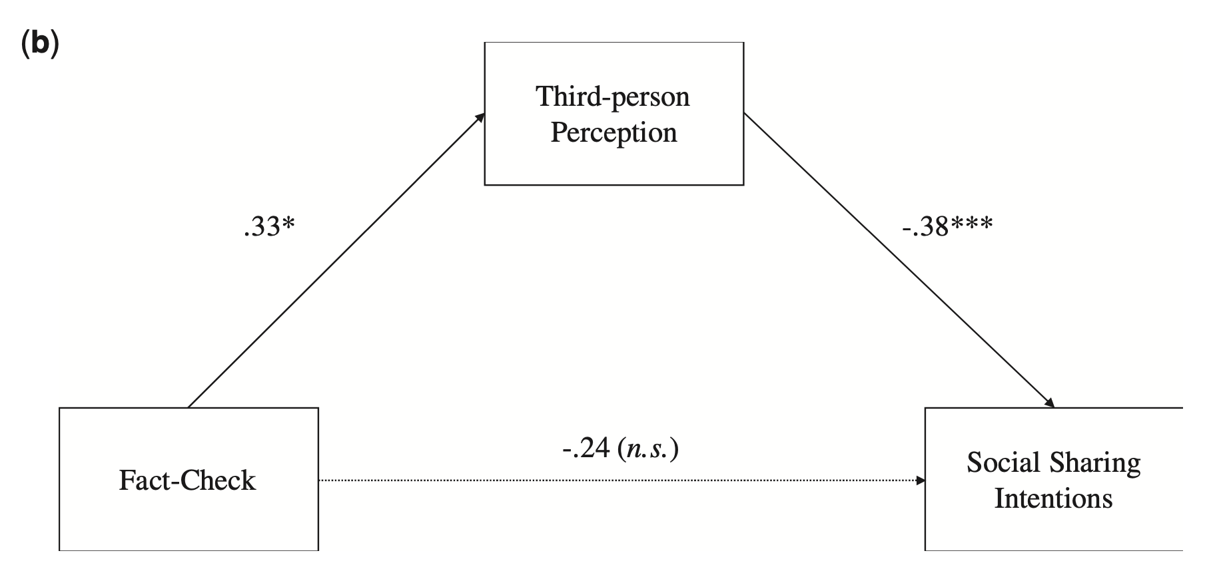
Study 2
H3: Support
Notes:
The analysis revealed that fact-checking information decreased social sharing intentions via TPP

Slide 23
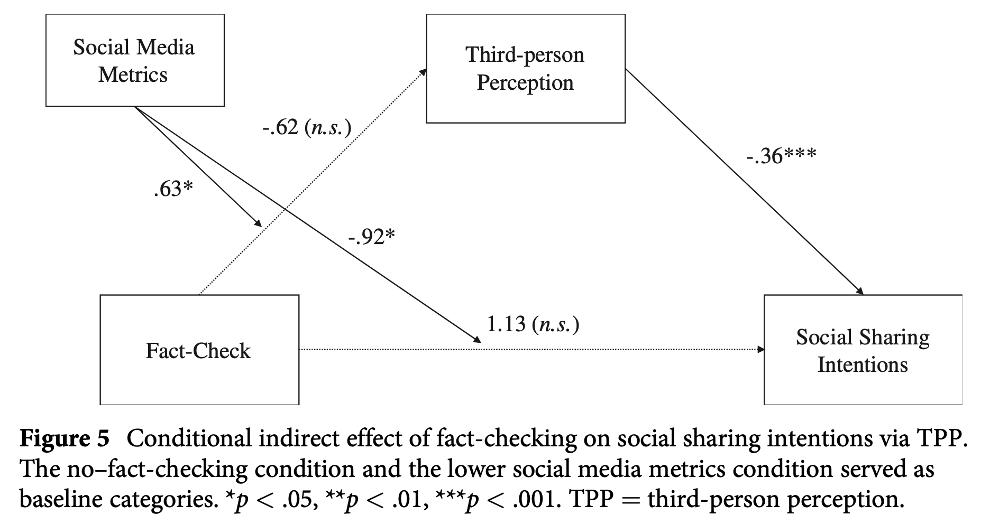
Study 2
H4

Slide 24
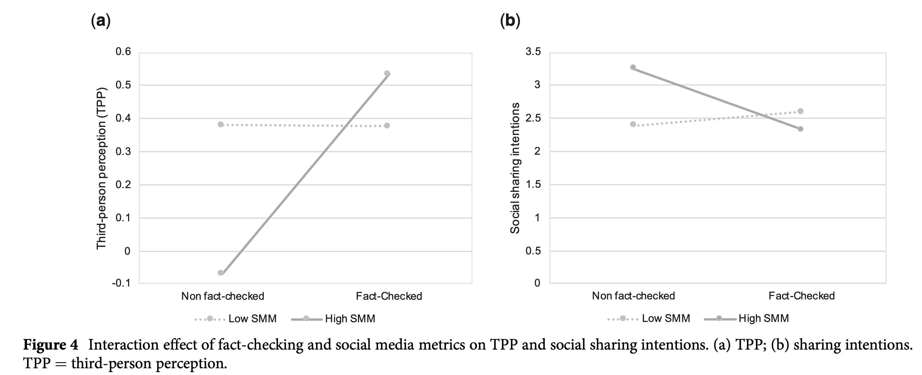
Study 2
H4: Reject
When there was no fact-checking, those who viewed the news with higher social media metrics reported a significantly smaller TPP than those who viewed the news with lower social media metrics
However, when the news was debunked by fact-checking information, exposure to higher social media metrics, as compared to exposure to lower social media metrics, did not lead to a smaller TPP

Slide 25
Study 2
H4: reject
In the no–fact-checking condition, participants who read the news with higher social media metrics reported significantly greater intentions to share the news on social media than those who read the news with lower social media metrics
In contrast, in the fact-checking condition, exposure to higher social media metrics did not lead to greater social sharing intentions than exposure to lower social media metrics

Slide 26
Key takeaway
Fact-checking information alerted people that the news they read was fake and thus increased TPP. Increased TPP, in turn, led individuals to be less likely to share the news on social media
Increased TPP as a function of fact-checking was largely due to reduced media influence on the self, rather than than increased media influence on others
Fact-checking may make participants resist the influence of low-quality media content (i.e., fake news) on themselves, and such a perception was the driving force of behavioral intentions.
Fact-checking information invalidates the power of social media metrics (i.e., bandwagon effect)
When participants did not recognize that they read fake news (i.e., no fact-checking information provided), they were susceptible to the influence of social media metrics in presuming media influence and shaping social sharing intentions.
In contrast, when participants were informed that the news they read was false, their estimates of media influence and social sharing intentions were not swayed by the number of likes or shares.
Notes:
Other scholar have argued that PME3, not PME1, is the key predictor of changes in attitude and behavior
In previous studies, high social media metrics (i.e., large number of likes and shares) were found to reduce the self-other discrepancy in perceived media influence and to sub- sequently increase intentions to share the media content on social media, as people took high social media metrics as a bandwagon cue.
It is pos- sible that participants interpreted social media metrics differently when they learned the news was false. That is, the fact that a fake news story has been liked and shared by many people could signal a wider reach of harmful content, which in turn led to a different presumption of media influence and, subsequently, different actions

